Slide 1
Helping Parents to Help their Children Primary to Secondary Transition & 11+ Preparations Kerrie Mumford Assistant Head Westcliff High School for Boys

Slide 2
Transition from Primary to Secondary
The transition from Primary to Secondary can be challenging -
Style of lessons
Amount of homework
Level of independence required
Organisation
Academic rigour
Work habits
Good habits formed during Year 5 and 6 will not only help prepare for the 11+ examination, but will instil academic rigour and good work habits which will make the transition to any secondary school much smoother.

Slide 3
Grammar School Myths & Legends
“Grammar Schools are exam factories”
We get good results because we are selective – we also offer a huge host of extra-curricular and enrichment activities. Have a look at our Westcliff Diary for example, or come along to one of our Go for Grammar! Saturdays to see what we can offer beyond the classroom - http://whsb.essex.sch.uk/444/community/wcgc-go-for-grammar-
“The Grammar Schools prioritise high 11+ scores”
All the Grammar Schools have allocated places for local pupils. At WHSB we have 139 of our 185 Year 7 places for local boys. We only allocate places to outside the priority area when we have run out of local pupils.
“It is very difficult to pass the 11+”
A Score of 303 for local pupils is required – this is usually between 50-75% in the test.
Tutoring is not needed – all the grammar schools agree that we do not want pupils who have been intensively tutored – All content is covered in Year 5 lessons. Familiarisation with the test format is necessary though to give pupils a chance.
“The uniform is really expensive”
Our compulsory items cost less than £100 and will probably last for two years.

Slide 4
11+ Mathematics

Slide 5
Structure of the Examination
22 – 26 questions (possibly with parts to them)
60 minutes
“sound understanding of level 4/5 Mathematics”
Non-calculator

Slide 6
Topic - Number
Addition, subtraction of decimals and fractions
Long multiplication (including decimals and fractions) and division (including fractions)
Conversion (g to kg, m to cm etc)
Rearranging numbers to make an expression correct
Prime, square, even, odd, factors and multiples
Percentage increase and decrease
Highest common factor and lowest common multiple
Ratio and recipes
Order of operations

Slide 7
Topic – Number Example 1

Slide 8
Topic – Number Example 2

Slide 9
Topic – Number Example 3

Slide 10
Topics - Shape
Nets of cuboids
Area and Perimeter
Properties of shapes (squares, parallelograms, trapezium, rhombus, kite)
Symmetry through shading of a shape
Symmetry through completing a shape
Angles on a straight line and in a triangle
3-D objects and volume

Slide 11
Topic – Shape Example 1

Slide 12
Topic – Shape Example 2

Slide 13
Topic – Shape Example 3

Slide 14
Topics - Data
Bar charts
Venn diagrams and probability
Two way tables
Pie charts
Mean, median and mode

Slide 15
Topic – Data Example 1

Slide 16
Topic – Data Example 2

Slide 17
Topic – Data Example 3

Slide 18
Topics - Algebra
Algebraic addition and subtraction
Algebraic substitution
Linear sequences
Contextual questions
Assigning letters with values

Slide 19
Topic – Algebra Example 1

Slide 20
Topic – Algebra Example 2

Slide 21
Topic – Algebra Example 3

Slide 22
Helping with Maths
All of these examples are simply to highlight standard topic questions, they do not cover every possible question
Many questions are in context
Practise contextual questions the most

Slide 23
Helping with Maths
Encourage problem solving:
Day to day problems
Don’t help, let them figure it out for you
Encourage confidence

Slide 24
Helping with Maths
Ask questions:
Differences in methods
Differences in language
Prompt him with questions

Slide 25
Helping with Maths
Please don’t tell your son that you can’t do Maths (so that might be why he is struggling):
Even if he is struggling with a topic, simply applying to a Grammar school and being willing to take the 11+ means that he is above the average ability in the country.

Slide 26
Helping with Maths
Encourage the use of diagrams/tables:
They clarify problems, allow pupils to visualise the problem and encourage systematic working.
Encourage them to try an easier case:
If a problem is complicated, can it be simplified or can a smaller problem be tackled first?

Slide 27
Helping with Maths
Pupils who are very successful at Mathematics approach problems logically and systematically. Those who aren’t tend to rush in and do something with the numbers, however illogical that may be.

Slide 28
Good Mathematicians:
Understand the problem (by using diagrams/tables and playing around with some numbers)
Plan their approach (look at a simpler case and build up, for example)
Carry out their work
Evaluate their answer (i.e. check it is reasonable)

Slide 29
Help In School
Ask the teacher in the school
Try familiarisation papers available on the CSSE website
Attend Help Sessions when they are offered
Use educational websites (e.g. BBC Bitesize, MyMaths if the school has a subscription)

Slide 30
11+ English

Slide 31
The English Paper Components
Section | Skill | Time Allowed | Approx. Marks
Reading Time | - | 10mins | -
Section One | Comprehension | 30mins | 30
Section Two | Applied Reasoning | 10mins | 5
Section Three | Continuous Writing | 20mins | 15

Slide 32
Section One: Content
Text likely to come from a classic source, e.g. C19th or early C20th
Several multiple choice questions
Need awareness of devices like similes and metaphors
One long vocabulary question worth around 12 marks
Summary skills: Explain what Character A thinks of Character B
Need to be able to place the text in its context – what clues are there it was written in the past?

Slide 33
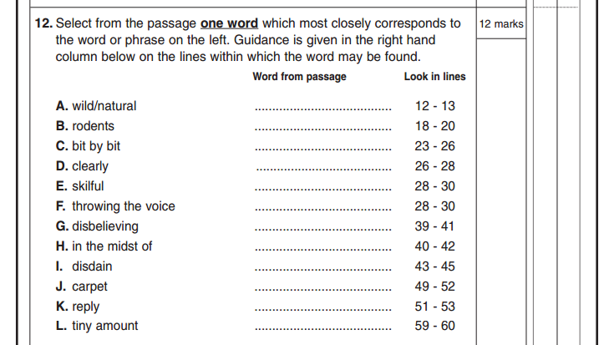
Sample Vocabulary Questions
feral
rats
piecemeal
distinctly
adroit
ventriloquism
incredulous
amid
unconcern
Axminster
rejoinder
shred

Slide 34
Shared Reading of Classic Texts
Suggested titles:
Treasure Island – Robert Louis Stevenson
Black Beauty – Anna Sewell
Oliver Twist – Charles Dickens
The Secret Garden – Frances Hodgson Burnett
The Call of the Wild / White Fang – Jack London

Slide 35
Learning to Summarise
Discuss your shared reading together.
“Let’s summarise the main events of what we read tonight.”
“What do you think were the three most important things that happened in this chapter?”

Slide 36
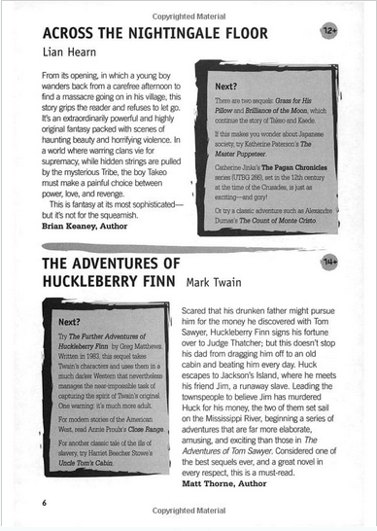
Reading for Pleasure

Slide 37
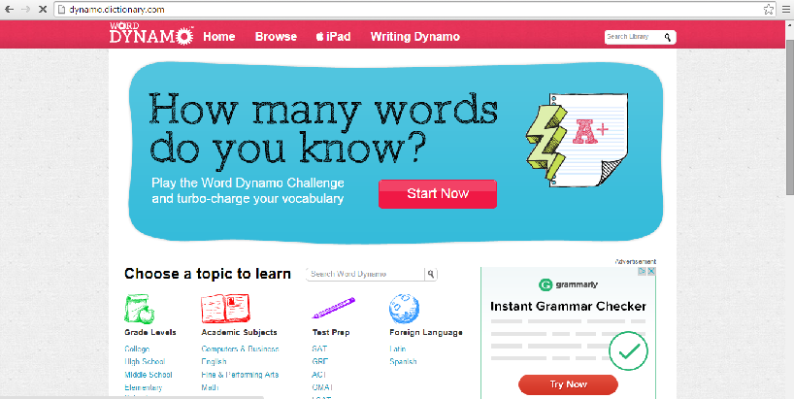
Useful Websites for Developing Vocabulary
www.vocabulary.com
Word Dynamo: www.dynamo.dictionary.com

Slide 38
Family Games to Aid Learning
‘Articulate for Kids’
‘Don’t Say It!’
‘Think! Words’
‘Last Word’

Slide 39
Section Two – Applied Reasoning
Essentially English verbal reasoning
Download free past papers from different exam boards at www.elevenplusexams.co.uk
Educational games online: www.woodlands-junior.kent.sch.uk
Prefixes and suffixes flashcards for free download at www.havefunteaching.com
Reliable published workbooks include Bond and CGP.

Slide 40
Sample Applied Reasoning Question
Home practice: How many words can you make with a letter ‘t’ somewhere inside them?
cactus attack rickety antonym

Slide 41
Spelling and Letter Games

Slide 42
Section Three: Continuous Writing
Two writing questions (both need to be completed)
One piece of descriptive writing
One piece of factual writing (informative/instructional)

Slide 43
Continuous Writing - Improving Content
Reading (again!)
Write a description in the same style as a favourite author– “Can you invent your own...?”
Use images to stimulate descriptive writing
Encourage the use of similes, metaphors and onomatopoeia
Practise expressing the same idea using different sentence structures
Provide non-fiction texts (fact books; things to make and do)
Create silly instruction guides, e.g. explaining to an alien how to brush your teeth

Slide 44
How to Improve Technical Accuracy
Listen to work being read aloud
Ask them to proofread; read work backwards to check spellings
Insist on practice where spelling errors occur (‘look, cover, write, check’)
Explain the rule, not the answer
Dots in the margin to indicate errors
Use a grown-ups’ guide: www.oxforddictionaries.com/grammar

Slide 45
Tips from the Parents’ Association
Ask your child’s Primary School teachers about their 11+ chances. They will be able to give advice regarding your child’s strengths and weaknesses. Remember: not all children are suited to a selective Grammar School education.
Take an interest in what your child is doing with plenty of positive encouragement and support. Broaden your child’s mind with visits to museums, galleries, and other places of interest.
Get hold of past papers – the CSSE provides downloadable familiarisation papers that are free of charge: http://csse.org.uk/
Look at 11+ study guides. There are a plethora of books and practice papers available to buy at good booksellers and online retailers.
Set reasonable targets. Your child already does a day’s work at school and may have homework too, so don’t overdo it. Sitting down and doing practice papers within the given time limits can be helpful.
Don’t make the 11+ exams the “be all and end all”. Rather than telling your child “You’ve got to get into this school”, say something like, “Let’s just have a go at it”. Have a “Plan B” in the event of your child not being successful.
Make sure your child eats well, sleeps well, and gets lots of fresh air, exercise, and time to relax and to play. A structured routine in the run-up to the exams is beneficial – and remember that the 11+ day takes place less than a month after the start of the Autumn Term and following the long summer break.
Ensure your child has an early night and healthy breakfast before the exams. Afterwards, don’t do a lengthy debrief – and don’t comment on any mistakes your child might have made. If they are upset or worried, reassure them that they have done their best.
If a place at a selective Grammar School has been secured, ensure your child works hard for the remainder of Year 6. They are expected to adapt quickly once in Year 7 and it is easy to make a slow start.
Your child will need to be far more organised at Secondary School than at Primary School. Establishing a routine in the morning and evening will help the day start smoothly and with minimum stress. Ensure your child always has a sensible and healthy breakfast – this will help them to concentrate!

Slide 46
Applying for the Test
Applications open on May 4 2017
Applications close on July 21 2017
You do not need to sit the test at the school you want to go to – that decision comes later.
Apply through the CSSE Website
www.csse.org.uk

Slide 47
What if I can’t do my best?
On the Day of the Test
Test instructions will be sent from the CSSE that are specific to the school you have chosen to sit at. Check the school (your chose is not guaranteed), the date and the registration details as well as the instructions for the day.
Variations include –
Parking/travel instructions
Registration time and arrangements
Snacks
Collection time
What if I can’t do my best?
Illness
Family circumstances
Call the CSSE at the earliest opportunity to explain the circumstance and ask to be transferred to the alternative day (Tuesday 27 September)
Call the school to explain – leave a message on the switch board if you get no answer immediately

Slide 48
What happens next?
Results will be published by early October
Some schools will have an ‘Information Evening’ – for example, you can visit WHSB on Wednesday 18 October in the afternoon or evening
The CSSE will send the results, along with an explanation of the likelihood of a place at each of the selective schools. The Information Evenings are a good opportunity to clarify your chances of gaining a place at that particular school
Use the Common Application Form to select your choices for schools by 31 October 2017

Slide 49
I didn’t achieve 303 points, but there is a good reason why…
You still need to apply to the school of your choice. Opting for Grammar 1 and Grammar 2 will have no impact on your place at Comprehensive 1.
On National Results Day (1 March 2018), if you do not get your place of choice (Grammar or Comprehensive) you can submit an appeal. Details on how to appeal will be with your letter, but you cannot appeal to a school you have not chosen on your application form.
Appeals are usually heard in April or early May.

Slide 50
Questions?

